Slide 1
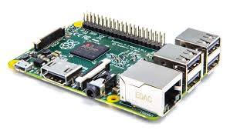
LED Driver for Raspberry PI
Rafael López
Ramiro Rubio
Víctor Ramírez

Slide 2
Problem
Control an external LED using RaspberryPi2 using a char driver instead of a high level of abstraction library
Provide a library to use this driver
Show it on a running demo application

Slide 3
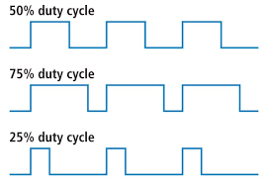
Solution
We created a loadable Kernel module able to interface directly with the on board GPIOs
This module is a char driver that has a node in /dev/ that can be writen to drive high or low a GPIO either with echo or system calls
Our implementation includes a library that uses system calls to write directly at the node
For the application the library includes basic functions to:
Turn on a LED
Turn off a LED
Set Period
PWM Mode

Slide 4
Conclusion
Kernel versions and Kernel headers must match for a module to build
We actually see a working char driver and also how to communicate an application with a Kernel module
Currently the PWM mode is not exact, because we don’t use a high definition timer.
The PWM mode is implemented in a blocking fashion

